Slide 1
Lord of the Flies
Power Struggles in World War II
How the conflict and power struggle among major countries involved in World War Two are presented in Lord of the Flies.
By Stephanie Yao, Kelly Sun, Wendy Yuan
Notes:
a proposal on our potential future research about the power struggles in WWII.
The research question is How the conflict and power struggle among major countries involved in World War Two are presented in Lord of the Flies.

Slide 2
CONTENT
Part 01
Research Motivation
Part 04
Literature Review and Thesis
Part 02
Context of the Topic
Part 05
The Significance/ Limitation of the Research
Part 03
Research Question and Methodology
Lord of the Flies
Notes:
The following sections are included in the research proposal:

Slide 3
Power Struggle in World War II
Part 01
Research
Motivation

Slide 4
Great Impact of World War II
The aftermath of World War II brought significant societal changes
Shifts in class dynamics
Shifts in economic structures
Shifts in power relations
Exploring the topic offers an opportunity to gain insights into the ways in which literature reflects and interprets these post-war social transformations, shedding light on the tensions and power struggles within a changing social hierarchy.
Lord of the Flies

Slide 5
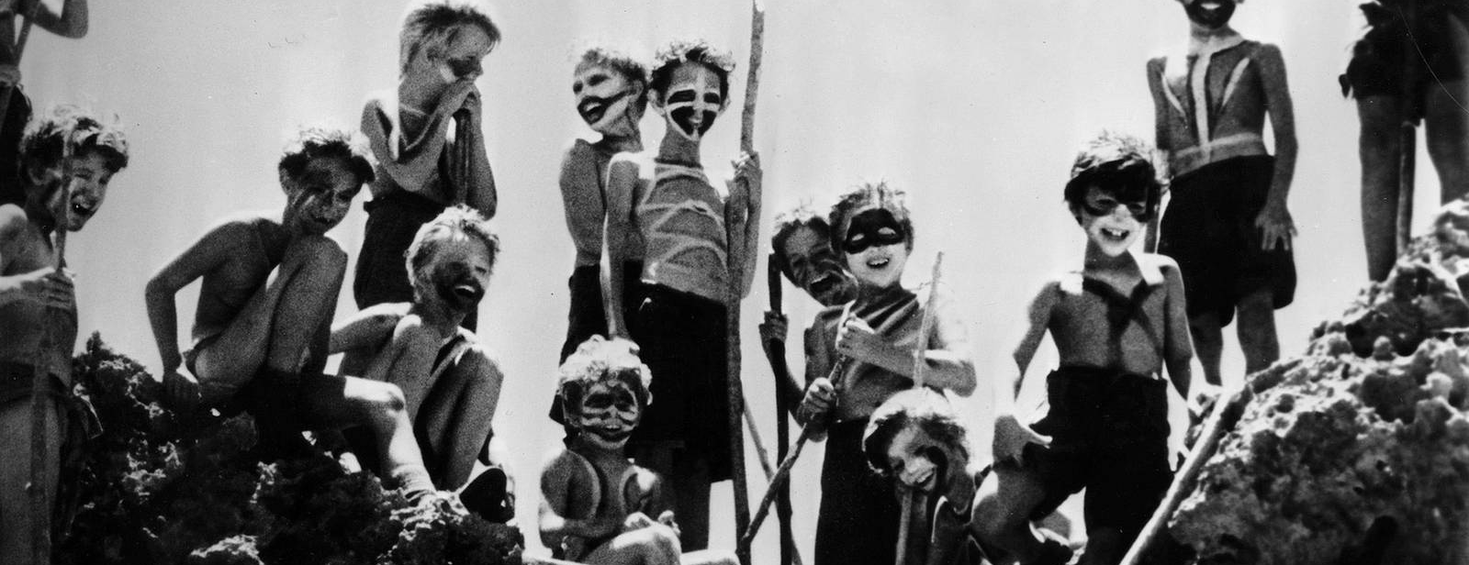
Significant symbolism and allegory in LOTF
Using the microcosm of the island to symbolize larger societal structures and power dynamics
Deeper understanding of the novel's commentary on post-World War II social divisions
Notes:
Lord of the Flies uses the microcosm of the island to symbolize larger societal structures and power dynamics, making it a rich source for examining how the conflicts between different social classes are portrayed and dissected. By analyzing these representations, a deeper understanding of the novel's commentary on post-World War II social divisions and their impacts can be attained.

Slide 6
Historical Background
Part 02
Context of the Topic
Notes:
Then, I would like to introduce the context of the topic, WWII.

Slide 7
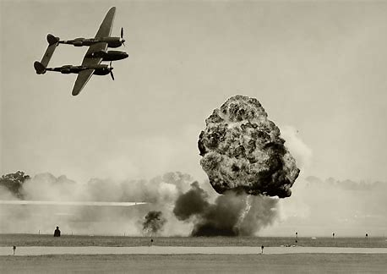
Historical Background Regarding World War II
Started by German Nazi from September 1st, 1939 by attaching Poland. The vast majority of the world's countries, including all the great powers, fought as part of two opposing military alliances: the Allies and the Axis.
Notes:
Who: German Nazi
When: September 1st, 1939
Iconic Event: Attacking Poland
The reason for starting WWII was to externalize the impact of internal economic crisis brought by Great Depression

Slide 8
Power Struggle During World War II
Allied Powers vs. Axis Powers
Allies- the United States, the Soviet Union, and the United Kingdom
Axis- Germany, Italy, and Japan.
Eastern Front
The Soviet Union and Nazi Germany.
Pacific Theater
The division between the United States, China and Japan.
Occupation of Europe
The division of Europe between the Allied and Axis powers.
Notes:
The power struggle during world war II is generally divided into the allies and axis powers by their different political views held.
By geographic position, it can be divided into the Eastern Front, pacific, and European areas.
includes

Slide 9
Question and Procedure
Part 03
Research Question and Methodology

Slide 10
Research Question
How the conflict and power struggle among major countries involved in World War Two are presented in Lord of the Flies
What are the major stakeholder countries involving in the power struggle in WWI?
Explore the correlation between the Lord of the Flies and the WWII countries, and how the characters can correspond with the countries.
Relate the historical background to the theme of the novel.

Slide 11
Research Methodology
Primary Research
Textual Analysis
Complementary
study
01
02
03
Interviewed two history professor.
Did a close reading of the Lord of the Flies.
Studied some complementary essays and texts.

Slide 12
Lord of the flies and other contemporaneous literature.
Part 04
Literature Review and Thesis

Slide 13
Thesis Statement
Power is an entity’s or individual’s ability to control or direct others
Authority is influence that is predicated on perceived legitimacy.
During and after World War II, power and authority have also been a major theme.
Thesis Statement: The World War II, started as a result of German's jealousy of power, shows the cruelty of power conflict in a way that resembles the power conflict between Ralph and Jack, and Lord of the Flies reveals the substantial consequence of the war through the character Jack.

Slide 14
Source of Lord of the Flies
Theme of Power
Democracy
Dictatorship
"There aren't any grownups. We shall have to look after ourselves." The meeting hummed and was silent. "And another thing. We can't have everybody talking at once. We'll have to have 'Hands up' like at school." He held the conch before his face and glanced round the mouth.
x
The chief was sitting there, naked to the waist, his face blocked out in white and red. "Tomorrow," went on the chief, "we shall hunt again." He pointed at this savage and that with his spear.
Elected leader Ralph
Conch: a powerful symbol of democratic power
Democracy quickly breaks down as fear and violence take hold
Self-Elected leader Jack
Rules this group with fear and terror
'the Chief'

Slide 15
Source of Lord of the Flies
Germany & Jack
The power battle between Ralph and Jack, with Ralph emerging triumphant, represents the power struggle between Western democracies and Germany that led to World War I and soon to World War II.
Power Conflict

Slide 16
Source of Lord of the Flies
Consequences
Lord of the flies: - Jack’s murder of two boys
- Jack influences most of the boys on the island to follow his insane lead
World War II: - representative of Hitler’s senseless murder.
-Hitler's regime brainwashed millions into following his lead, before and during the war,
through propaganda.
x

Slide 17
Other Contemporaneous literature
Offers a powerful commentary on the rise of totalitarianism and the power struggles
About an ex-docker sent out by the Labor government to govern a colonial dependency
During the Spanish Civil War
Themes of political ideology, power struggles, and the brutality of war
Animal Farm
His Excellency
For Whom the Bell Tolls
Notes:
His Excellency is about social class differentiation since the labor government is a very upper-class figure.
Animal farm: an allegorical novel, on a farm in England, previously called Manor Farm, though when the animals take it over, they rename it Animal Farm. The farm acts as a metaphor for a period of political upheaval in Russia and some European countries. Animal Farm suggests that the corruption and bloodshed of Stalinism is much closer to reality than British readers may realize.
For Whom the Bell Tolls is written by Ernest Hemingway with the Spanish Civil War as its background setting, revealing themes of political ideology, power struggles, and the brutality of war. The story tells a young American volunteer fighting with a Republican guerrilla unit against Franco’s nazi forces. The novel drew on the author’s own experiences as a reporter for the North American Newspaper Alliance during WWII.

Slide 18
Evaluating the research
Part 04
The Significance/ Limitation of the research

Slide 19
Significance/limitation of the research
Significance
Limitation
Provide new ideas for the interpretation of Post- WW II literatures
Fills the gap in academia
Stimulate deeper thinking on the subject of power and to shed some light on the management in modern societies.
Sampling bias
Lack of historical document records regarding the power distribution and classes conflicts within Europe during WW II

Slide 20
Bibliography
[1] World War II and Social Class in Great Britain, A. MARWICK [2] https://www.bbc.co.uk/bitesize/guides/zgmfdmn/revision/3
[3] How is William Golding’s Lord of the Flies an allegory for World War Two? - eNotes.com. (1970, January 1). ENotes. https://www.enotes.com/homework-help/how-william-goldings-lord-flies-an-allegory-world-714182
[4] https://courses.lumenlearning.com/wm-introductiontosociology/chapter/introduction-to-power-and-authority/#:~:text=Power%20is%20an%20entity’s%20or%20individual’s%20ability%20to,power%20is%20necessary%20but%20not%20sufficient%20for%20authority.

Slide 21
Lord of the Flies
THANKS for Listening

